Slide 1

18.404/6.840 Lecture 24
Last time:
- Probabilistic computation
- The class BPP
- Branching programs
- Arithmetization
- Started showing $EQ\text{ROBP}∈$ BPP
Today: (Sipser §10.2)
- Finish $EQ\text{ROBP}∈$ BPP
Posted: Sample problems for the final exam
(to be held on Thursday, December 17).

Slide 2




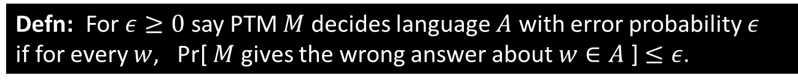



Review: Probabilistic TMs and BPP
Defn: A probabilistic Turing machine (PTM) is a variant of a NTM where each computation step has 1 or 2 possible choices.
deterministic
step
coin flip step -
each choice has
50% probability
Defn: For $ε≥0$ say PTM $M$ decides language $A$ with error probability $ε$
if for every $w$, Pr[ $M$ gives the wrong answer about $w∈A$ ] $≤ε$.
Defn: BPP $=\left\{A\right|$some poly-time PTM decides $A$ with error $ε=1/3$ }
Amplification lemma: $2^{\text{−}poly\left(n\right)}$
Check-in 24.1
Actually using a probabilistic algorithm presupposes a source of randomness.
Can we use a standard pseudo-random number generator (PRG) as the source?
Yes, but the result isn’t guaranteed.
Yes, but it will run in exponential time.
No, a TM cannot implement a PRG.
No, because that would show P = BPP.
computation tree
for $M$ on $w$
branch $b$
$$w∈A$$
$$w∉A$$
Pr[ branch $b$ ] $=2^{−k}$ where $b$ has $k$ coin flips
Pr[ $M$ accepts $w$ ] $=$
Pr[ $M$ rejects $w$ ] $=1−$Pr[ $M$ accepts $w$ ]
$$\sum_{\text{b} \text{accepts} }{Pr⁡[ \text{branch} b ]}$$
Many accepting
Few
rejecting
Few accepting
Many rejecting
Check-in 24.1

Slide 3






Review: Branching Programs
Defn: A branching program (BP) is a directed, acyclic (no cycles) graph that has
1. Query nodes labeled $x_{i}$ and having two outgoing edges labeled 0 and 1.
2. Two output nodes labeled 0 and 1 and having no outgoing edges.
3. A designated start node.
Theorem: $EQ\text{BP}$ is coNP-complete (on pset 6)
Defn: A BP is read-once if it never queries a variable more than once
on any path from the start node to an output.
Defn: $EQ\text{ROB}\text{P}$ $=\left\{〈B_{1},B_{2}〉\right| B_{1}$ and $B_{2}$ are equivalent read-once BPs$\}$
Theorem: $EQ\text{ROBP}∈$ BPP
Proof idea: Run $B_{1}$ and $B_{2}$ on a randomly selected non-Boolean input and accept if get same output.
Method: Use arithmetization (simulating ∧ and ∨ with $+$ and $×$)
to define BP operation on non-Boolean inputs.
$$B_{1}$$
$$B_{2}$$
$$x_{1}$$
$$x_{4}$$
0
1
0
1
0
1
0
1

Slide 4














Boolean Labeling
Alternative way to view BP computation
Show by example: Input is $x_{1}=\text{0}, x_{2}=\text{1}, x_{3}=\text{1}$
The BP follows its execution path.
Label all nodes and edges on the execution path with 1
and off the execution path with 0.
Output the label of the output node 1.
$x_{1}$
1
1
0
1
0
1
$$x_{2}$$
$$x_{2}$$
0
1
0
Obtain the labeling inductively by using these rules:
0
1
0
1
0
0
0
1
$$a$$
$x_{i}$
$$a_{2}$$
$x_{3}$
$$x_{3}$$
1
0
$$a_{1}$$
$$a_{3}$$
0
0
0
1
$$a∧\overline{x_{i}}$$
0
1
0
1
$$a∧x_{i}$$
$$a_{1}∨a_{2}∨a_{3}$$
0
0
1
1
= output
Label outgoing edges from nodes
Label nodes from incoming edges

Slide 5


















Arithmetization Method
Method: Simulate $∧$ and $∨$ with $+$ and $×$.
$a∧b → a×b=ab$
$\overline{a} → \left(1−a\right)$
$a∨b → a+b−ab$
$x_{1}$
0
1
Replace Boolean labeling with arithmetical labeling
Inductive rules:
Start node labeled 1
$$x_{2}$$
$$x_{2}$$
1
0
0
1
$$a_{2}$$
$x_{3}$
$$x_{3}$$
$$a$$
$$a_{1}$$
$$a_{3}$$
1
0
$x_{i}$
0
1
0
1
$$a_{1}+a_{2}+a_{3}$$
$$a∧\overline{x_{i}}$$
$$a_{1}∨a_{2}∨a_{3}$$
$$a (1−x_{i})$$
$$a x_{i}$$
$$a∧x_{i}$$
Simulate $∨$ with $+$ because the BP is acyclic.
The execution path can enter a node
at most one time.
0
1

Slide 6























Non-Boolean Labeling
Use the arithmetized interpretation of the BP’s computation to define its operation on non-Boolean inputs.
Example: $x_{1}=\text{2}, x_{2}=\text{3}$ Output = $−7$
Recall labeling rules:
1
$x_{1}$
$$a$$
$x_{i}$
$$a_{2}$$
0
1
$$a_{1}$$
$$a_{3}$$
0
1
$$1\left(2\right)=2$$
$$a (1−x_{i})$$
$$a x_{i}$$
$$−1=1\left(1−2\right)$$
$$a_{1}+a_{2}+a_{3}$$
$$−1$$
$$2$$
$$x_{2}$$
$$x_{2}$$
Algorithm sketch for $EQ\text{ROBP}$: “On input $〈B_{1},B_{2}〉$
1. Pick a random non-Boolean input assignment.
2. Evaluate $B_{1}$ and $B_{2}$ on that assignment.
3. If $B_{1}$ and $B_{2}$ disagree then reject.
If they agree then accept.”
More details and correctness proof to come.
First some algebra…
0
1
1
0
$$2=−1\left(1−3\right)$$
$$2\left(1−3\right)=−4$$
$$−3=−1\left(3\right)$$
$$2\left(3\right)=6$$
$$8=2+6$$
0
1
$$\left(−3\right)+\left(−4\right)=−7$$

Slide 7

Roots of Polynomials
Let $p\left(x\right)=a_{0}x^{d}+a_{1}x^{d−1}+a_{2}x^{d−2}+⋯+a_{d}$ be a polynomial.
If $z$ is some constant and $p\left(z\right)=0$ call $z$ a root of $p$.
Polynomial Lemma: If $p\left(x\right)≠0$ is polynomial of degree $≤d$ then $p$ has $≤d$ roots.
Proof by induction (see text).
Corollary 1: If $p_{1}(x)$ and $p_{2}(x)$ are both degree $≤d$ and $p_{1}≠p_{2}$
then $p_{1}\left(z\right)=p_{2}(z)$ for $≤d$ values $z$.
Proof: Let $p=p_{1}−p_{2}$.
Above holds for any field $𝔽$ (a field is a set with $+$ and $×$operations that have typical properties).
We will use a finite field $𝔽_{q}$ with $q$ elements where $q$ is prime and $+$, $×$operate mod $q$.
Corollary 2: If $p\left(x\right)≠0$ has degree $≤d$ and we pick a random $r∈𝔽_{q}$, then Pr$\left[ p\left(r\right)=0 \right]≤d/q$.
Proof: There are at most $d$ roots out of $q$ possibilities.
Theorem (Schwartz-Zippel): If $p\left(x_{1}, …, x_{m}\right)≠0$ has degree $≤d$ in each $x_{i}$ and
we pick random $r_{1},…, r_{m}∈𝔽_{q}$ then Pr$\left[ p\left(r_{1},…, r_{m}\right)=0 \right]≤{md}/q$
Proof by induction (see text).
roots

Slide 8


Slide 9
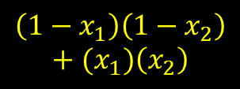
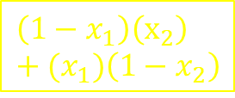






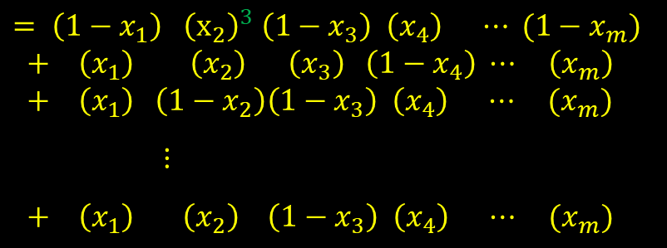













Symbolic Execution
Leave the $x_{i}$ as variables and obtain an expression in the $x_{i}$ for the output of the BP.
Recall
labeling rules:
$$a$$
$x_{i}$
$$a_{2}$$
$$a_{1}$$
$$a_{3}$$
1
0
1
$x_{1}$
$$a (1−x_{i})$$
$$a x_{i}$$
0
1
$$a_{1}+a_{2}+a_{3}$$
$$\left(1−x_{1}\right)$$
$$x_{1}$$
Exponents $≤1$
due to “read-once”
Assume read exactly once so that for each $i$ ${(x}_{i})$ or ${(1−x}_{i})$ appears in every row
$$\left(1−x_{1}\right)$$
$$x_{1}$$
$$x_{2}$$
$$x_{2}$$
$= \left(1−x_{1}\right) {\left(x_{2}\right)}^{3} \left(1−x_{3}\right) \left(x_{4}\right) ⋯ (1−x_{m})$
$+ \left(x_{1}\right) \left(x_{2}\right) \left(x_{3}\right) \left(1−x_{4}\right) ⋯ \left(x_{m}\right)$
$+ \left(x_{1}\right) \left(1−x_{2}\right)\left(1−x_{3}\right) \left(x_{4}\right) ⋯ (x_{m})$
$⋮$
$+ \left(x_{1}\right) \left(x_{2}\right) \left(1−x_{3}\right) \left(x_{4}\right) ⋯ (x_{m})$
1
1
form of output
0
0
$$(1−x_{1})\left(1−x_{2}\right)$$
$$(x_{1})\left(1−x_{2}\right)$$
$$\left(1−x_{1}\right)(x_{2})$$
$$(x_{1})\left(x_{2}\right)$$
$$\left(1−x_{1}\right)\left(1−x_{2}\right)+(x_{1})\left(x_{2}\right)$$
0
1
$$\left(1−x_{1}\right)\left(x_{2}\right)+(x_{1})\left(1−x_{2}\right)$$
Corresponds to the True rows in the truth table of the Boolean function
$=$ output

Slide 10








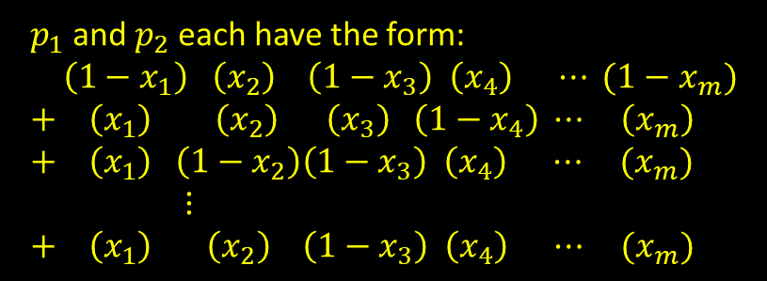

$EQ\text{ROBP}∈$ BPP
Algorithm for $EQ\text{ROBP}$ $=$ “On input $〈B_{1},B_{2}〉$ [on variables $x_{1},…, x_{m}$]
1. Find a prime $q≥3m$.
2. Pick a random non-Boolean input assignment $r=r_{1}, …, r_{m}$ where each $r_{i}∈𝔽_{q}$.
3. Evaluate $B_{1}$ and $B_{2}$ on $r$ by using arithmetization.
4. If $B_{1}$ and $B_{2}$ agree on $r$ then accept.
If they disagree then reject.”
Claim: (1) $B_{1}≡B_{2}→$Pr$\left[ p_{1}\left(r\right)=p_{2}\left(r\right) \right]=1$
(2) $B_{1}≢B_{2}→$ Pr$\left[ p_{1}\left(r\right)=p_{2}\left(r\right) \right]≤1/3$
Proof (1): If $B_{1}≡B_{2}$ then they agree on all Boolean inputs.
Thus their functions have the same truth table.
Thus their associated polynomials $p_{1}$ and $p_{2}$ are identical.
Thus $p_{1}$ and $p_{2}$ always agree (even on non-Boolean inputs).
Proof (2): If $B_{1}≢B_{2}$ then $p_{1}≠p_{2}$ so $p=p_{1}−p_{2}≠0$.
From Schwartz-Zippel, Pr$\left[ p_{1}\left(r\right)=p_{2}\left(r\right) \right]≤{dm}/q≤m/{3m}=1/3$.
(Note that $d=1$.)
$$B_{1}$$
$$B_{2}$$
Check-in 24.2
If the BPs were not read-once, the polynomials might have exponents $≥1$. Where would the proof fail?
$B_{1}≡B_{2}$ implies they agree on all Boolean inputs
Agreeing on all Boolean inputs implies $p_{1}=p_{2}$
Having $p_{1}=p_{2}$ implies $p_{1}$ and $p_{2}$ always agree
$$x_{1}$$
$$x_{4}$$
0
1
0
1
0
1
0
1
arithmetize
$$p_{1}$$
$$p_{2}$$
$p_{1}$ and $p_{2}$ each have the form:
$\left(1−x_{1}\right) \left(x_{2}\right) \left(1−x_{3}\right) \left(x_{4}\right) ⋯ (1−x_{m})$
$+ \left(x_{1}\right) \left(x_{2}\right) \left(x_{3}\right) \left(1−x_{4}\right) ⋯ \left(x_{m}\right)$
$+ \left(x_{1}\right) \left(1−x_{2}\right)\left(1−x_{3}\right) \left(x_{4}\right) ⋯ (x_{m})$
$⋮$
$+ \left(x_{1}\right) \left(x_{2}\right) \left(1−x_{3}\right) \left(x_{4}\right) ⋯ (x_{m})$
Check-in 24.2

Slide 11

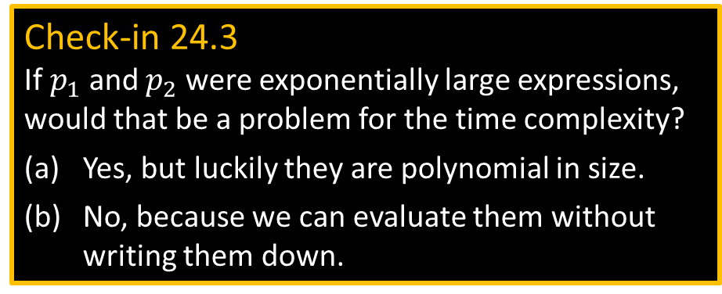
$EQ\text{ROBP}∈$ BPP
Algorithm for $EQ\text{ROBP}$ $=$ “On input $〈B_{1},B_{2}〉$ [on variables $x_{1},…, x_{m}$]
1. Find a prime $q≥3m$.
2. Pick a random non-Boolean input assignment $r=r_{1}, …, r_{m}$ where each $r_{i}∈𝔽_{q}$.
3. Evaluate $B_{1}$ and $B_{2}$ on $r$ by using arithmetization.
4. If $B_{1}$ and $B_{2}$ agree on $r$ then accept.
If they disagree then reject.”
Claim: (1) $B_{1}≡B_{2}→$Pr$\left[ p_{1}\left(r\right)=p_{2}\left(r\right) \right]=1$
(2) $B_{1}≢B_{2}→$ Pr$\left[ p_{1}\left(r\right)=p_{2}\left(r\right) \right]≤1/3$
Proof (1): If $B_{1}≡B_{2}$ then they agree on all Boolean inputs.
Thus their functions have the same truth table.
Thus their associated polynomials $p_{1}$ and $p_{2}$ are identical.
Thus $p_{1}$ and $p_{2}$ always agree (even on non-Boolean inputs).
Proof (2): If $B_{1}≢B_{2}$ then $p_{1}≠p_{2}$ so $p=p_{1}−p_{2}≠0$.
From Schwartz-Zippel, Pr$\left[ p_{1}\left(r\right)=p_{2}\left(r\right) \right]≤{dm}/q≤m/{3m}=1/3$.
(Note that $d=1$.)
$$B_{1}$$
$$B_{2}$$
Check-in 24.3
If $p_{1}$ and $p_{2}$ were exponentially large expressions, would that be a problem for the time complexity?
Yes, but luckily they are polynomial in size.
No, because we can evaluate them without writing them down.
$$x_{1}$$
$$x_{4}$$
0
1
0
1
0
1
0
1
arithmetize
$$p_{1}$$
$$p_{2}$$
$p_{1}$ and $p_{2}$ each have the form:
$\left(1−x_{1}\right) \left(x_{2}\right) \left(1−x_{3}\right) \left(x_{4}\right) ⋯ (1−x_{m})$
$+ \left(x_{1}\right) \left(x_{2}\right) \left(x_{3}\right) \left(1−x_{4}\right) ⋯ \left(x_{m}\right)$
$+ \left(x_{1}\right) \left(1−x_{2}\right)\left(1−x_{3}\right) \left(x_{4}\right) ⋯ (x_{m})$
$⋮$
$+ \left(x_{1}\right) \left(x_{2}\right) \left(1−x_{3}\right) \left(x_{4}\right) ⋯ (x_{m})$
Check-in 24.3

Slide 12

Quick review of today
Simulated Read-once Branching Programs by polynomials
Gave probabilistic polynomial equality testing method
Showed $EQ\text{ROBP}∈$ BPP

